Slide 1


Highlander Contacting Database Application
Neil L.

Slide 2
Highlander Contracting
Contracting Company (Maryland)
Highlander specializes in complete lifecycle support of fiber optic systems and utility installations.
Cost Effective - (General, Electrical, HVAC, Data (Fiber Optic), Fire Alarm)
Provide quality and innovative cost-effective solutions for our clients.

Slide 3
Functionality
Employee Management (Creation, Removal, etc.)
Contract Management
Regular User/Customer Management
Database Simplicity & Search Functionality

Slide 4
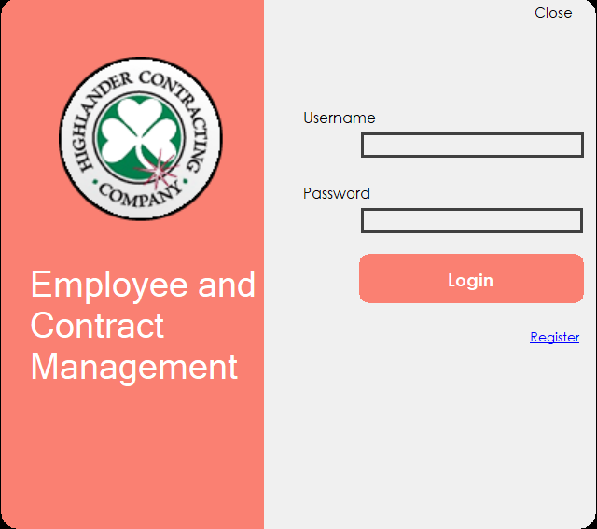
Login Page

Slide 5
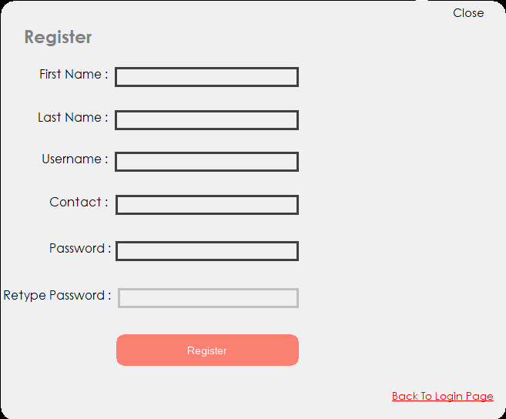
Registration Page

Slide 6
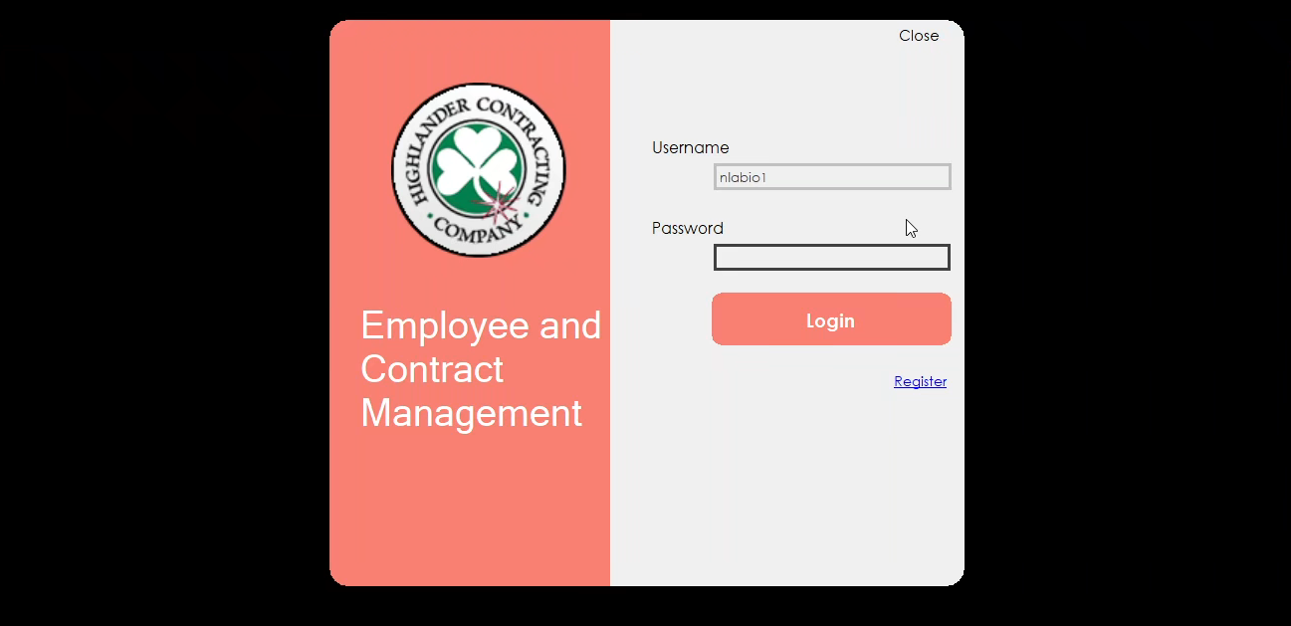
Regular User

Slide 7

Manager User

Slide 8

Admin User

Slide 9
Conclusion
Database Application w/ multiple functionalities
Database implementation
Full control of database data and modification
User compatibility and application ease

